Slide 1

SMART INTRUDER DETECTION SYSTEM
by
Sravani P
Roll No:234G5A3210
Vyshnavi G
Roll No:224G1A32B9
Siraj Ahammad C
Roll No:224G1A3290
Sohith Kumar Reddy B
Roll No:224G1A3292
Under the guidance of
^{Dr. D. Rajesh Babu} M. Tech, Ph.D.
Associate Professor
Department of Computer Science and Engineering (Data Science)
Srinivasa Ramanujan Institute of Technology
(Affiliated to JNTUA & Approved by AICTE) (Accredited by NAAC with ‘A’ Grade & Accredited by NBA (EEE, ECE & CSE)
Rotarypuram Village, B K Samudram Mandal, Ananthapuramu – 515701.
2025 - 2026

Slide 2
Abstract
Smart Intruder Detection System
The Smart Intruder Detection System enhances security in restricted areas to detect and identify intruders, even in dark or low-light condibtions. The system continuously monitors the surroundings using a PIR sensor to detect human motion, an ultrasonic sensor to identify vehicle movement, and a sound sensor to capture unusual acoustic activities. A USB camera is used for real-time face detection when motion or abnormal activity is detected. Upon identifying a potential intruder, the system triggers visual and audio alerts through LEDs and a buzzer, ensuring immediate indication of security threats. By combining sensor data processing with image-based monitoring, the proposed system enhances accuracy, reduces false alarms, and offers a cost-effective, scalable approach for modern security applications in restricted areas.
Srinivasa Ramanujan Institute of Technology

Slide 3
Contents
Smart Intruder Detection System
Introduction
Literarture Survey
Existing System
Proposed System
Ojectives
Planning & Design
Implementation
Results(screenshots)
Conclusion
References
Paper Submission proof
Srinivasa Ramanujan Institute of Technology

Slide 4
Introduction
Smart Intruder Detection System
The Smart Intruder Detection System is an intelligent security solution designed to enhance safety in homes, offices, and restricted environments by integrating multiple sensors with a Raspberry Pi controller. The system continuously monitors its surroundings using a PIR sensor to detect human motion, an ultrasonic sensor to sense vehicle movement, and a sound sensor to capture unusual acoustic activities. When any abnormal condition is detected, a USB camera activates to perform real-time face detection, while LEDs and a buzzer provide immediate visual and audio alerts. By combining sensor fusion with image-based monitoring, the system reduces false alarms and improves detection accuracy compared to traditional single-sensor systems. This cost-effective and scalable approach offers a reliable, automated, and smart security mechanism suitable for modern surveillance needs.
Srinivasa Ramanujan Institute of Technology

Slide 5
Literature survey
Smart Intruder Detection System
TITLE:Intrusion Detection for Smart Home AlarmSecurity System:Smart home security is increasingly essential in today’s world due to rising concernsover unauthorized access and property intrusion. Leveraging the capabilities of Raspberry Pi, a lowcost and efficient home security system is developed that combines motion detection, real-timeimage capture, SMS and email alerts, and automated door locking. The system uses OpenCV formotion tracking, a GSM module for text notifications, and a buzzer for local alarms, all integratedthrough Python scripts. A voltage regulator and backup battery ensure uninterrupted functionalityduring power outages. Testing showed over 90% accuracy in intrusion detection and prompt alertdelivery within seconds. The solution is both scalable and affordable, bridging the gap betweenhigh-cost commercial systems and the growing need for smart, userfriendly home protection. Futureimprovements include AIbased facial recognition, cloud storage, mobile app integration, andsupport for multiple surveillance nodes.
Srinivasa Ramanujan Institute of Technology

Slide 6
Literature survey
Smart Intruder Detection System
TITLE:Intruder Detection System Using Machine Learning-2025:This paper proposes an intelligent surveillance system that integrates motion detection, face recognition, and face mask detection using machine learning and computer vision techniques. The system enables real-time monitoring, identification, and alert generation, improving overall security and safety. It provides a scalable solution suitable for various environments such as public spaces and organizations. The study supports the use of advanced algorithms and real-time processing in enhancing intruder detection systems.
TITLE: Enhancing intrusion Detection: a hybrid machine and deep learning approach:This research focuses on improving intrusion detection in network systems using a hybrid model that combines machine learning and deep learning techniques. The model utilizes algorithms such as XGBoost, CNN, and LSTM for feature extraction and classification, achieving high accuracy and low false acceptance rates. The study highlights the importance of advanced detection techniques in handling large-scale data and evolving threats. This work emphasizes the role of intelligent algorithms in improving detection accuracy, which is relevant to modern security systems.
Srinivasa Ramanujan Institute of Technology

Slide 7
Literature survey
Smart Intruder Detection System
TITLE:A Smart Intruder Detection System :This paper presents an intruder detection system using PIR sensors and a Raspberry Pi camera to detect and capture images of intruders. The system uses OpenCV-based face recognition to compare captured images with stored authorized user data. If an unauthorized person is detected, the system sends an alert along with the image to the user via email. The study demonstrates an effective approach for real-time intruder detection and notification, forming a foundation for automated security systems.
TITLE: A New Smart Home Intruder Detection System Based on Deep Learning:This study introduces a smart home security system based on deep learning for face recognition using the EfficientNet-B4 model. The system is optimized for implementation on Raspberry Pi using transfer learning and lightweight model conversion. It achieves high accuracy even under varying lighting conditions and facial expressions. The research highlights the effectiveness of deep learning in enhancing face recognition performance, supporting the integration of intelligent image processing in intruder detection systems.
Srinivasa Ramanujan Institute of Technology

Slide 8
Smart Intruder Detection System
Existing System
Traditional intruder detection systems mainly rely on single-sensor mechanisms such as basic motion detectors or alarm-based systems. These cameras perform poorly in low-light or night-time conditions.These systems typically use only PIR sensors and simple CCTV cameras that require continuous human monitoring. Due to limited sensing capability, they often generate false alarms caused by pets, environmental changes, or background noise. Moreover, conventional models lack intelligent decision-making, real-time analysis, and integrated alert mechanisms, making them less reliable and inefficient for modern security requirements.

Slide 9
Proposed System
Smart Intruder Detection System
The proposed Smart Intruder Detection System integrates multiple sensors with a Raspberry Pi to enhance detection accuracy and reliability and This System enhances security in restricted areas to accurately detect and identify intruders, even in dark or low-light conditionsby using PIR, ultrasonic, and sound sensors and these all work together to identify human motion, vehicle movement, and abnormal sound events, while a USB camera enables real-time face detection upon intrusion. The system intelligently processes sensor data to trigger alarms only during abnormal conditions, activating a buzzer and visual indicators through LEDs. This multi-sensor, vision-assisted approach reduces false alarms, improves response time, and provides a smart, automated, and cost-effective security solution suitable for residential, commercial, and restricted environments.
Srinivasa Ramanujan Institute of Technology

Slide 10
Objectives
Smart Intruder Detection System
Intruder Detection in Low-Light and Abnormal Conditions:
The Smart Intruder Detection System is designed to accurately detect unauthorized individuals even in dark or low-light environments and during abnormal conditions. It continuously monitors restricted areas using a PIR sensor for human motion detection, an ultrasonic sensor for movement sensing, and a USB camera for real-time monitoring, all processed through a Raspberry Pi to ensure reliable and continuous surveillance.
2. Anomaly Detection and Intelligent Differentiation:
The system aims to intelligently differentiate between humans, animals, shadows, and other non-threatening movements by combining multi-sensor data with image-based analysis. Using sensor fusion techniques and OpenCV-based processing, the system minimizes unnecessary triggers and improves detection accuracy compared to traditional single-sensor security systems.
Srinivasa Ramanujan Institute of Technology

Slide 11
Contd…
Smart Intruder Detection System
Face Recognition and Voice/Sound Detection:
Another key objective is to implement real-time face recognition and sound detection to enhance security verification. The USB camera performs face detection and compares it with an authorized database, while the sound sensor detects unusual acoustic activities or suspicious voices, enabling the system to identify potential threats more effectively.
Instant Alert and Notification System:
The system is designed to provide immediate alerts when an intruder or abnormal activity is detected. It automatically captures images using the USB camera and sends them to authorized users through email notifications for quick response. Additionally, it activates LEDs and a buzzer to generate visual and audio alerts, ensuring real-time indication of potential security threats.
Srinivasa Ramanujan Institute of Technology

Slide 12
Contd…
Smart Intruder Detection System
Reduction of False Alarms:
The system aims to minimize false alarms by integrating multi-sensor data fusion, face recognition, and anomaly detection techniques. By intelligently distinguishing between humans, animals, shadows, and other non-threatening movements, the system improves detection accuracy and enhances the reliability of security monitoring compared to other systems.
Srinivasa Ramanujan Institute of Technology

Slide 13
Planning and Design
Smart Intruder Detection System
Hardware Requirements
Raspberry pi
Memory card
Usb camera
pir sensor
Ultrasonic sensor
sound sensor
Buzzer
Red led
Green led
Power supply
Adapter 12v
connectors-20
Software Requirements
Python
Open Cv
SMTPSS
Srinivasa Ramanujan Institute of Technology

Slide 14
Planning and Design
Smart Intruder Detection System
Power supply
Raspberry pi
Memory card
Buzzer
Usb camera
Led’s
pir sensor
Ultrasonic sensor
sound sensor
Srinivasa Ramanujan Institute of Technology

Slide 15
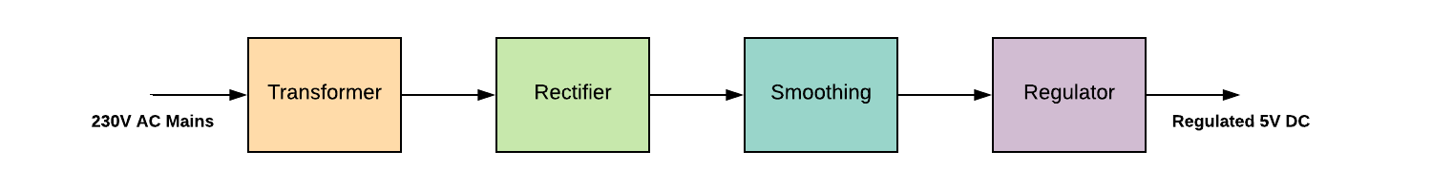
Planning and Design
Smart Intruder Detection System
A step-down transformer converts the 230V AC into12v.
The bridge rectifier is used to change AC to DC
A capacitor is used to filter the AC ripples and gives to the voltage regulator.
Finally voltage regulator regulates the voltage to 5V and finally, a blocking diode is used for taking the pulsating waveform.
Srinivasa Ramanujan Institute of Technology

Slide 16
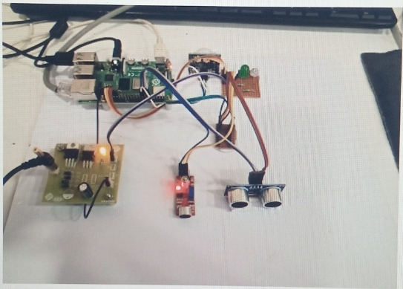
Implementation
Smart Intruder Detection System
components like Raspberry Pi, PIR sensor, ultrasonic sensor, sound sensor, camera, LED, and buzzer are connected and configured.
Python programming is used to read sensor data, control devices, and process inputs continuously.
OpenCV is implemented for image capture and basic face detection when an intrusion is detected.
Alert system is integrated to activate buzzer/LED and send email notifications with captured images in real time.
Srinivasa Ramanujan Institute of Technology

Slide 17
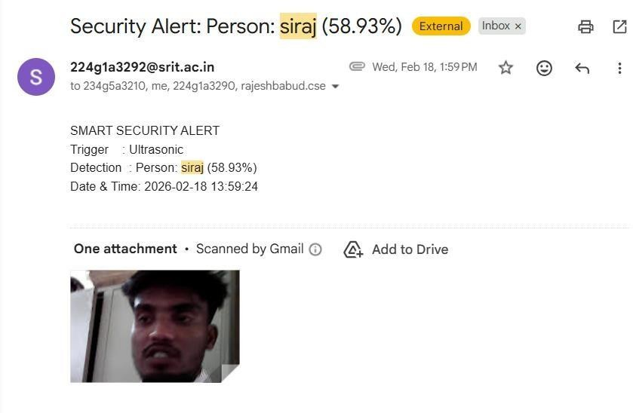
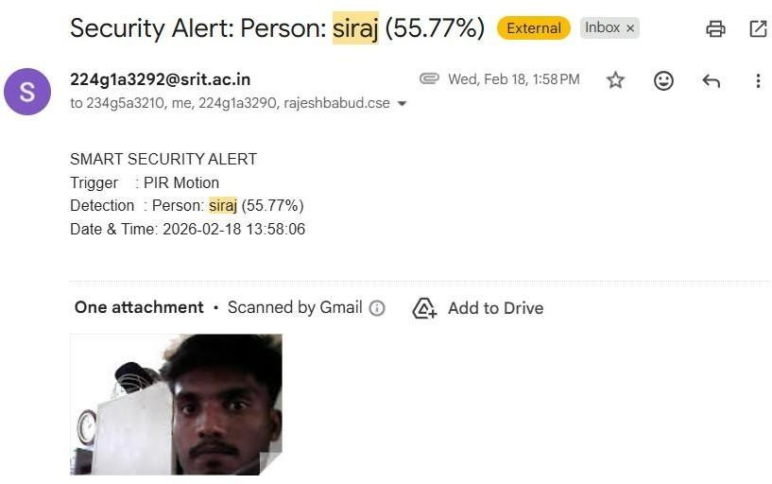
Results
Smart Intruder Detection System
Srinivasa Ramanujan Institute of Technology

Slide 18
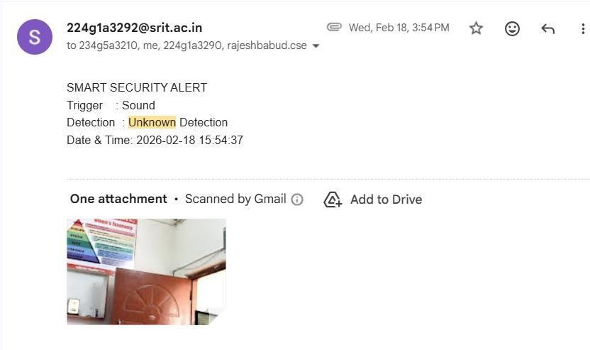
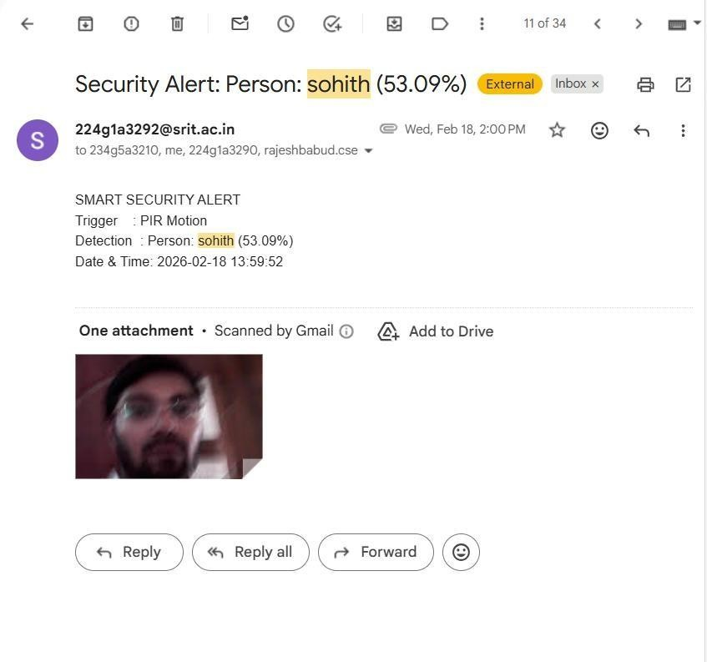
Results
Smart Intruder Detection System
Srinivasa Ramanujan Institute of Technology

Slide 19
Conclusion
Smart Intruder Detection System
The Smart Intruder Detection System provides an effective and automated security solution using Raspberry Pi and multiple sensors for accurate detection.
It successfully detects motion, sound, and suspicious activities even in low-light and dark environments, overcoming limitations of traditional systems.
The system generates real-time alerts with captured images, reducing the need for continuous human monitoring and improving response time.
Srinivasa Ramanujan Institute of Technology

Slide 20
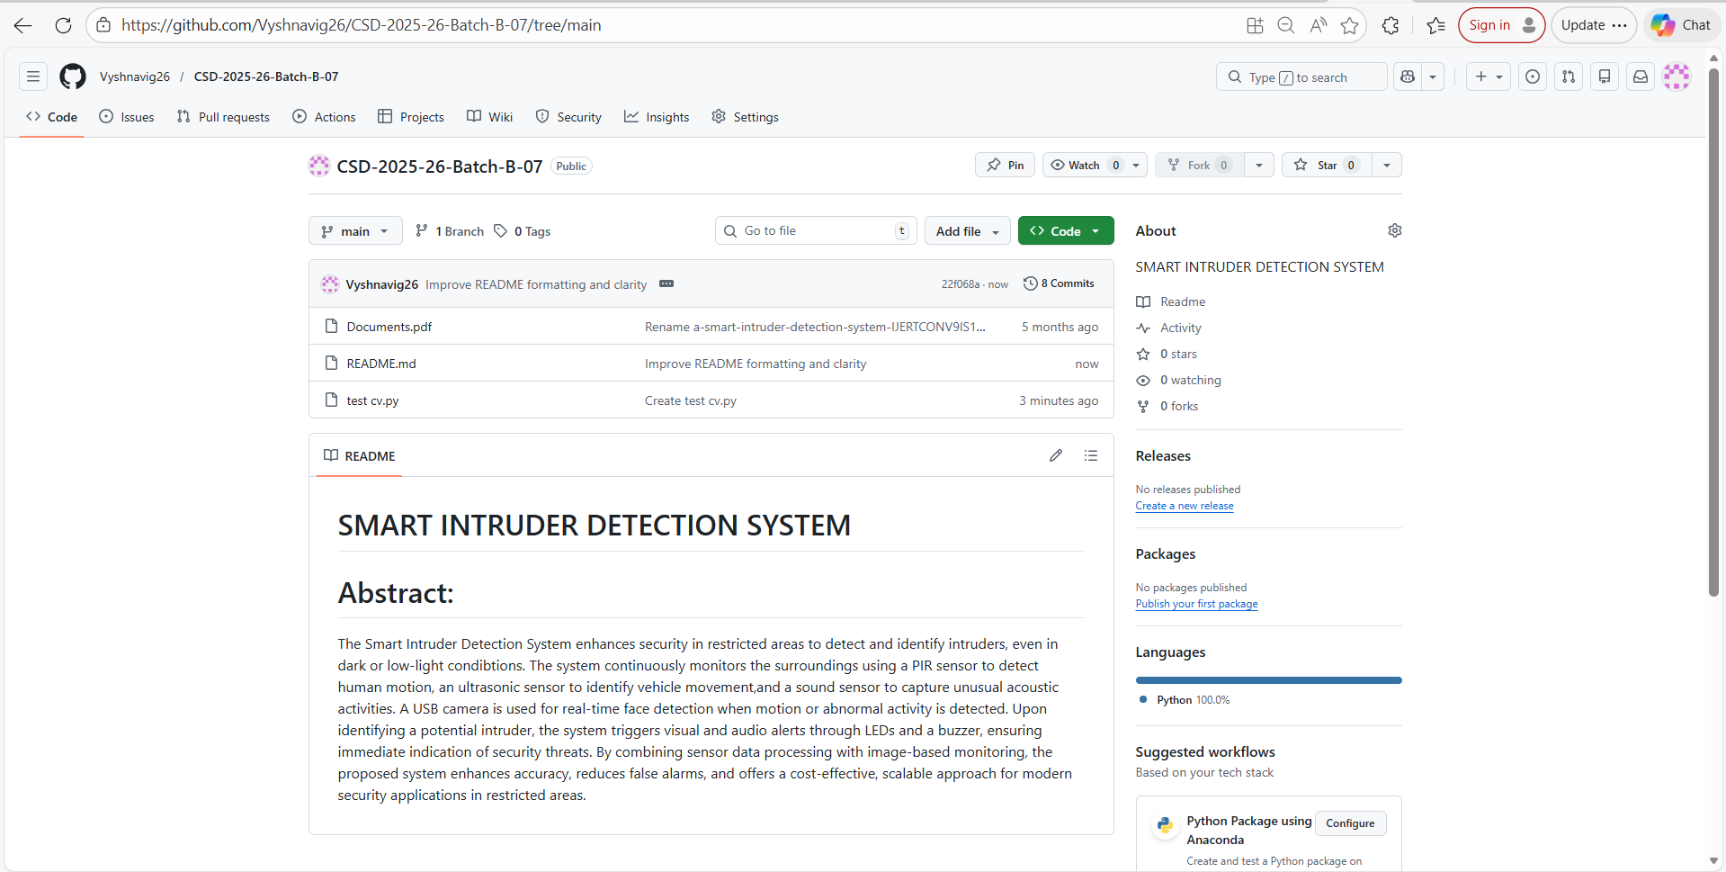
[1] Zaman, Fadhl [2] Parveen, Suraiya, and Javeria Shah. “A motion detection system in python and Oenc” 2021 third international conference on intelligent communication technologies and virtual mobile networks(ICICV).IEEE,2021.
Smart Intruder Detection System
GitHub
Repository Name : CSD-2025-26 Batch-B-07
Srinivasa Ramanujan Institute of Technology

Slide 21
[1] Zaman, Fadhl [2] Parveen, Suraiya, and Javeria Shah. “A motion detection system in python and Oenc” 2021 third international conference on intelligent communication technologies and virtual mobile networks(ICICV).IEEE,2021.
Smart Intruder Detection System
References
[1] Zaman, Fadhlan Hafizhelmi kamaru, et al. “Efficient human motion detection with adaptive background for vision-based security system.”(2017)
[2]S.Menaa, . “A Smar Intruder Detection System.” (IJERT)2021
[3]hiba Hameed Ali, . “A new smart home intruder detection system based on deep learning.”,ISSN ,2023
[4] Muhammad Sajid. “Enhancing intrusion detection: a hybrid machine and deep learning approach..” IEEE,2024.
[5] pawan game , “Intruder detection system using machine learning.” (IJERT) 2025
[6]MS. Mamata , “ Intruder detection for smart home alarm security system”, (IJERT) 2025
Srinivasa Ramanujan Institute of Technology

Slide 22
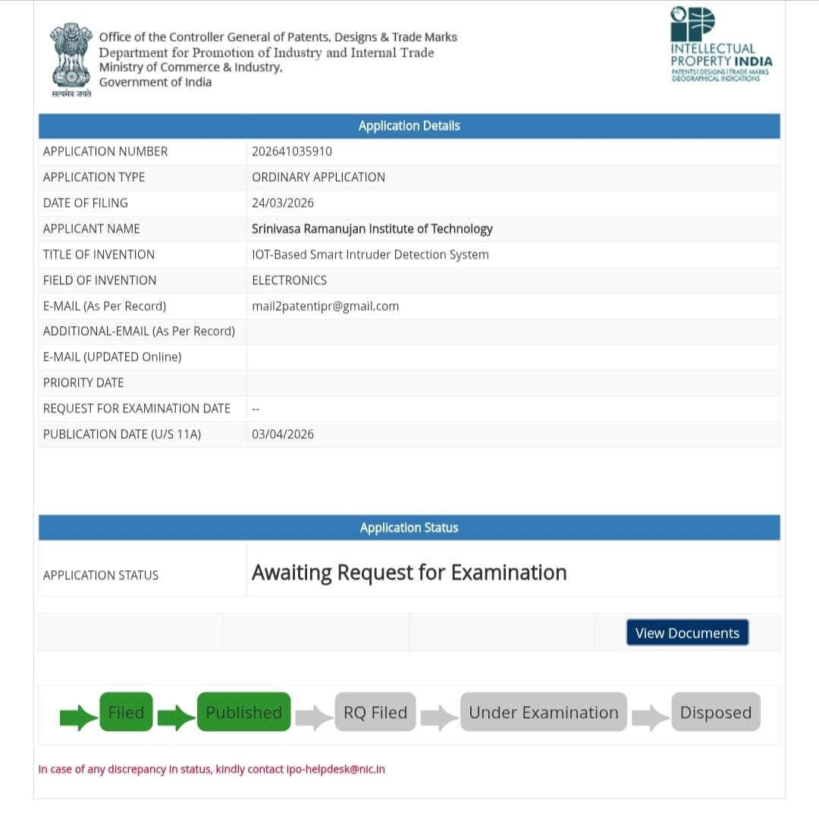
[1] Zaman, Fadhl [2] Parveen, Suraiya, and Javeria Shah. “A motion detection system in python and Oenc” 2021 third international conference on intelligent communication technologies and virtual mobile networks(ICICV).IEEE,2021.
Smart Intruder Detection System
Paper Submission Proof
Srinivasa Ramanujan Institute of Technology

Slide 23
Thank You!!!
Smart Intruder Detection System
Srinivasa Ramanujan Institute of Technology

